Slide 1
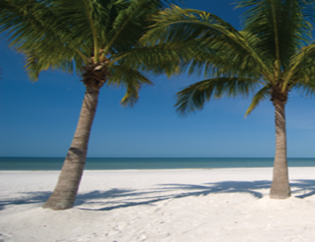
Name here presents
Legendary Rock n Roll
Music Association
Rock and Roll Hall of Fame Inductees
With six lead vocalist/multi-instrumental musicians, Ivory performs a potpourri of legendary rock from the decades of the 60's, 70's & 80's. Each of the original members is a strong lead vocalist allowing the band to create their famous and peerless soaring four and five part vocal harmonies. Their wealth of original music includes the popular hits You Are My Baby, Try Me, Comin From the City, Sweet Lady, and Tell Me Why. Ivory always puts the fans first and complements their set lists with legendary rock hits from the Eagles and Doobie Brothers; REO and .38 Special; Bob Seger and the Beach Boys; Styx, Loverboy and the power of pop rock's Journey and Boston.
This is the high energy rock n roll show that you have been waiting
to see! Don’t miss this one!
Date Here

Slide 2
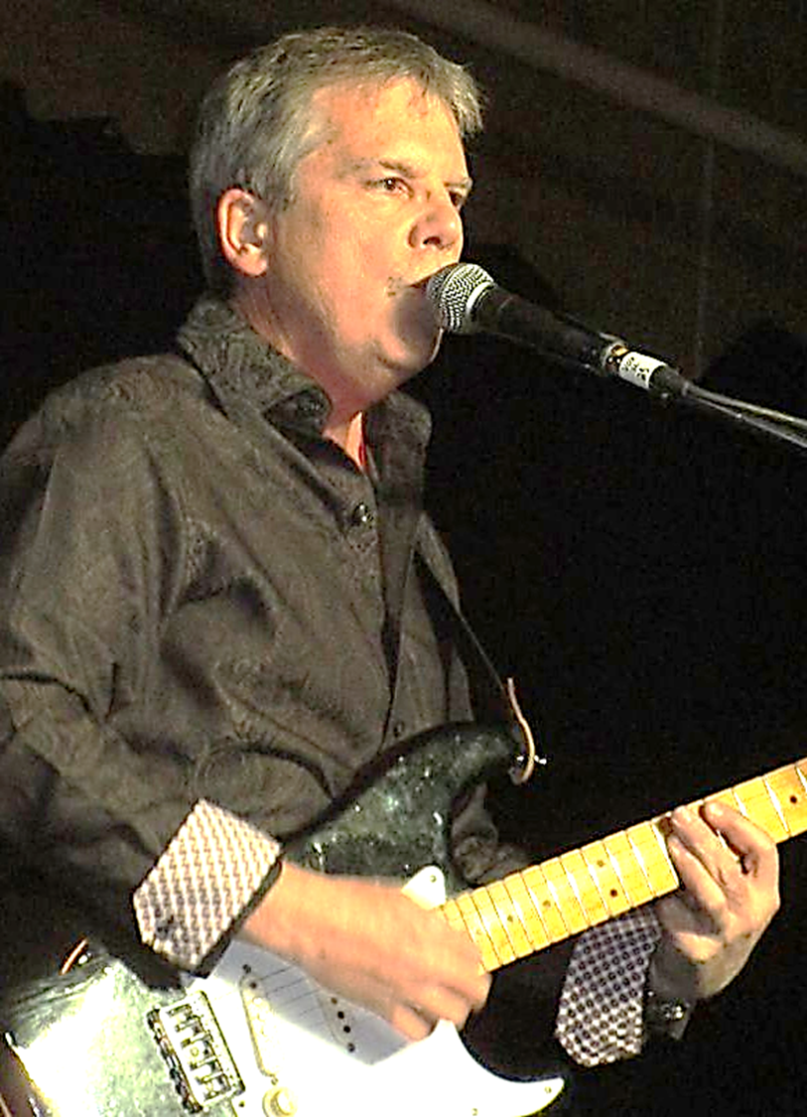
Curt
The Silver Spur welcomes the renowned concert performance group, IVORY. Known as South Dakota’s one and only Super Group, IVORY played over 200 concerts per year from 1975 through 1988. As the Midwest’s top drawing band; recording in Denver, Minneapolis and LA; and sharing concert stages with a host of arena-rock national recording artists, Ivory raised the bar for live performance bands with their myriad technical and stage innovations that created the legendary sight and sound experience for their record-setting sell-out crowds.
IVORY’s lineup features all the original members performing a select number of national concerts each year raising money for special events and charitable organizations.

